Slide 1
ICT 364 – Database Concepts & Terminologies
Week 2 – Introduction to Database Terminologies & Models

Slide 2
Weekly Objectives
Define database-related terms (tables, records, fields, schema).
Differentiate between data, information, knowledge.
Identify types of databases (hierarchical, network, relational, OODBMS).
Explain logical vs physical data models.

Slide 3
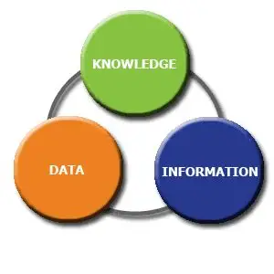
Data vs Information vs Knowledge
Data: Raw facts (e.g., “23, UEW, 2025”).
Information: Processed/organized data (e.g., “Student ID 23 belongs to UEW class of 2025”).
Knowledge: Interpreted info for decision-making (e.g., “Enroll Student 23 in graduation program”).

Slide 4
Basic Database Terminologies
Table (relation) → collection of rows & columns.
Record (Row/Tuple) → one entry.
Field (Column/Attribute) → category of data.
Schema → overall structure of a database.
Include a table diagram.

Slide 5
Types of Databases
Hierarchical – parent-child tree structure.
Network – multiple relationships with graph model.
Relational – tables linked with keys (most common).
Object-oriented – stores objects with attributes/methods.
Use icons/mini-diagrams to visualize.

Slide 6
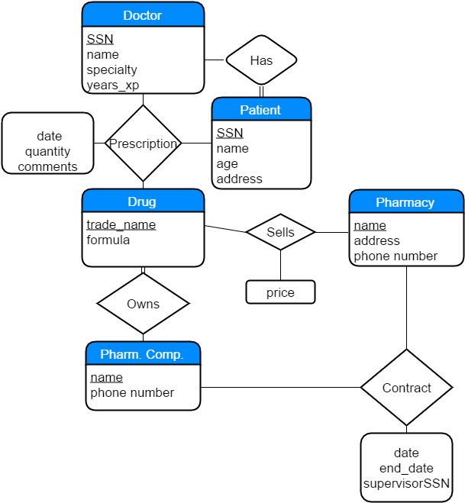
Data Models
Logical Model – abstract design (entities, attributes, relationships).
Physical Model – implementation details (tables, columns, indexes).

Slide 7
Examples of Databases
University student information system.
Banking system.
Social media platform.
Healthcare records.

Slide 8
Week 2 Activities
Forum: Data vs Information – real-world example.
Quiz: 3 MCQs (terminology & models).
Mini Assignment: Short report on types of databases.

